Slide 3
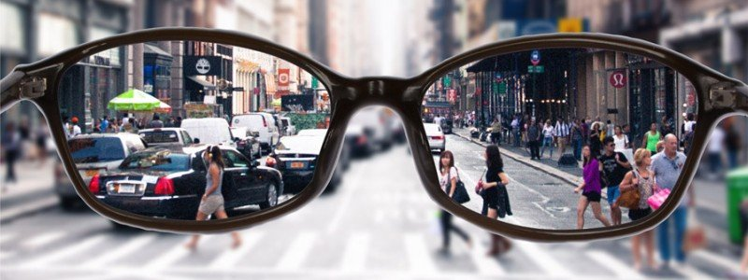
WE DON’T SEE THE WORLD AS IT IS…
WE SEE THE WORLD AS WE ARE

Slide 4
PROGRESSIVES
ACHIEVER
TRADITIONALISTS

Slide 5
PROGRESSIVES
ACHIEVER
TRADITIONALISTS

Slide 6
PROGRESSIVES
ACHIEVER
TRADITIONALISTS

Slide 7
HIGHER
GROUND

